Slide 1
FIR Workbook (lab_3)
SOC Design

Slide 2
Function specification
Same as course-lab_2(FIRN11stream)
y[t] = Σ (h[i] * x[t - i])

Slide 3
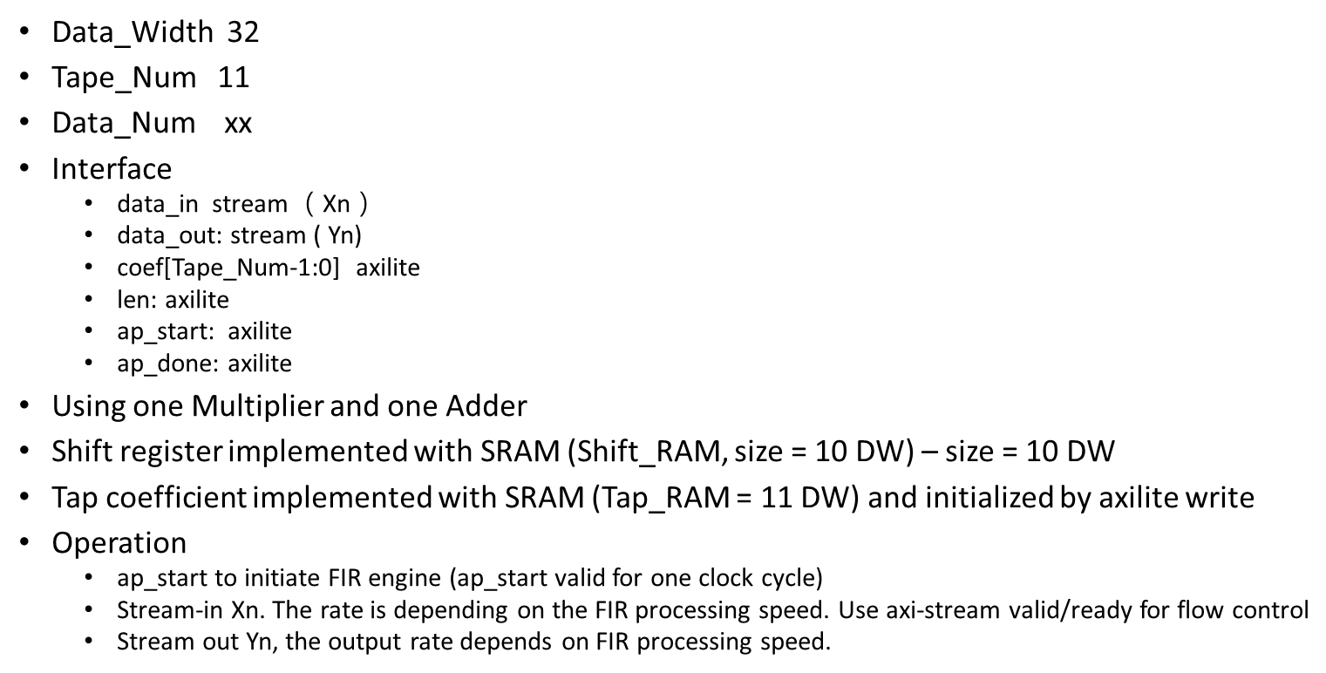
Design specification
TBD – Based on size of data file

Slide 4
Deliver module header
The I/O signals are listed in fir.v.
You are requested to use simplified AXI-lite and AXI-stream protocol.

Slide 5
Configuration Register Address map
0x00 – [0] - ap_start -> set when ap_start signal asserts
-> reset, when start data transfer, i.e. 1st axi- stream data come in
[1] – ap_done -> when FIR process all the dataset, i.e. receive tlast, and last Y is generated
[2] – ap_idle -> indicate FIR is actively processing data
0x10-14 - data-length
0x20-FF – Tap parameters,e.g 0x20-24 Tap0, in sequence …

Slide 6
FIR module interface
For your reference:
AXI-lite:
https://www.realdigital.org/doc/a9fee931f7a172423e1ba73f66ca4081
https://docs.xilinx.com/r/en-US/pg202-mipi-dphy/AXI4-Lite-Interface
AXI-stream:
https://developer.arm.com/documentation/ihi0051/latest/
https://docs.xilinx.com/r/en-US/pg256-sdfec-integrated-block/AXI4-Stream-Interface

Slide 7
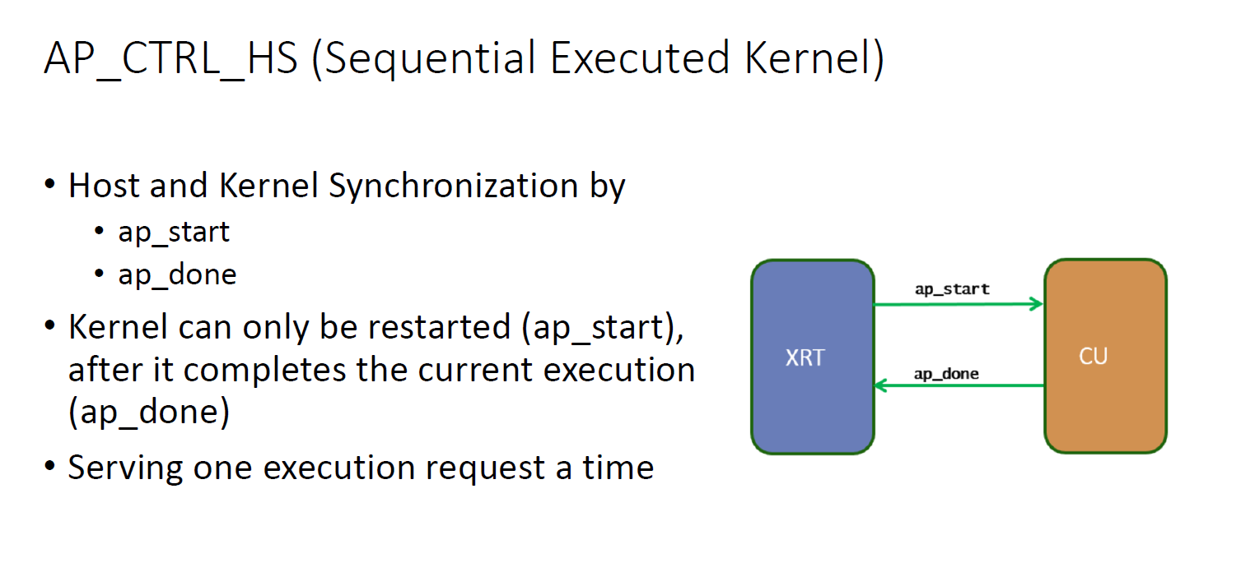
Testbench
fir_tb(Please name your top module same as fir for simulation)
The testbench should keep in the same directory with Makefile
Block-level Protocol (ap_start, ap_done):

Slide 8
Test dataset
Samples_triangular_wave.dat
out_gold.dat

Slide 9
Submission (1/2)
Hierarchy:
StudentID_lab3/
Waveform
Simulation.log
Report.pdf
Synthesis report
Github link
Your Github link should attach the file
Design, Synthesis report(Including FF, LUT, Bram ), Waveform, simulation.log, makefile,…etc.
Report
Location of design (If use vivado to design)
hostproject/hostproject.srcs/sources_1/new/

Slide 10
What is included in the report
Block Diagram
Datapath – dataflow
Control signals
Describe operation, e.g.
How to receive data-in and tap parameters and place into SRAM
How to access shiftram and tapRAM to do computation
How ap_done is generated.
…..
Resource usage: including FF, LUT, BRAM
Timing Report
Try to synthesize the design with maximum frequency
Report timing on longest path, slack
Simulation Waveform, show
Coefficient program, and read back
Data-in stream-in
Data-out stream-out
Bram access control
FSM

Slide 11
Submission (2/2)
Compress all above files in a single zip file named
StudentID_lab3.zip (e.g., 111061545_lab3.zip)
Submit to NTHU eeclass
Deadline:
‐ 20% off for the late submission penalty within 3 days

